Slide 1
Status of Denver-Julesburg Basin Drill Rig 1-hr NO2 Impacts Study
John Bunyak*, westar
*Input Obtained from Al Hendler (URS),
Bob Paine (AECOM), and Doug Blewitt
December 10, 2014

Slide 2
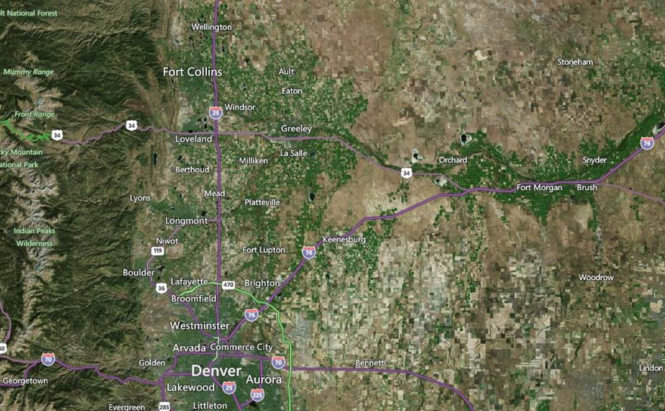
Site Location Selected for This Study: Northeast Colorado Near Platteville (Site access provided by Anadarko Petroleum Corp.)
Notes:
STUDY SITE IS NEAR PLATTEVELLE CO, ABOUT AN HOUR NORTHEAST OF DENVER

Slide 3
Study Approach
Continuously monitor NO and NO₂ emissions from the diesel engines that power a natural gas drilling rig
Continuously monitor 1-hour average levels NO and NO₂ in the near-field ambient air at 12 sites upwind, downwind, and crosswind to the drilling rig
Continuously monitor levels of O₃ in the ambient air at one upwind and downwind site
Continuously monitor wind speed and wind direction at one upwind and downwind site and on a 10-meter instrumented tower
Site 1 monitoring was conducted from October 9-27, 2014
Site 2 monitoring was conducted from November 3-17, 2014

Slide 4
Monitor Deployment
Monitors were mounted on portable trailers to facilitate moving the monitors as needed throughout the study periods
AERMOD modeling was conducted to help with the initial monitor placement
AERMOD results showed that the peak modeled NOx concentrations were located inside the drill pad
For Site 1, the monitors were positioned near the pad boundary based on predominant winds, but were not relocated due to constraints from airflow obstructions, limited access off the well pad, and accessibility of electricity to power the monitors
For Site 2, the monitors were repositioned based on prevailing wind forecasts

Slide 5
Site 1 Monitor Deployment
NO and NO₂ were monitored at 12 sites along the well pad perimeter
6 sites near the northwest corner of the well pad, oriented with respect to predominant daytime winds
6 sites near the southeast corner, oriented with respect to predominant nighttime winds

Slide 6
Site 1 Monitor Locations
Site 5
Site 6
Site 4
Site 3
Site 2
Site 1
Site 7
Site 8
Site 9
Site 10
Site 12
Site 11

Slide 7
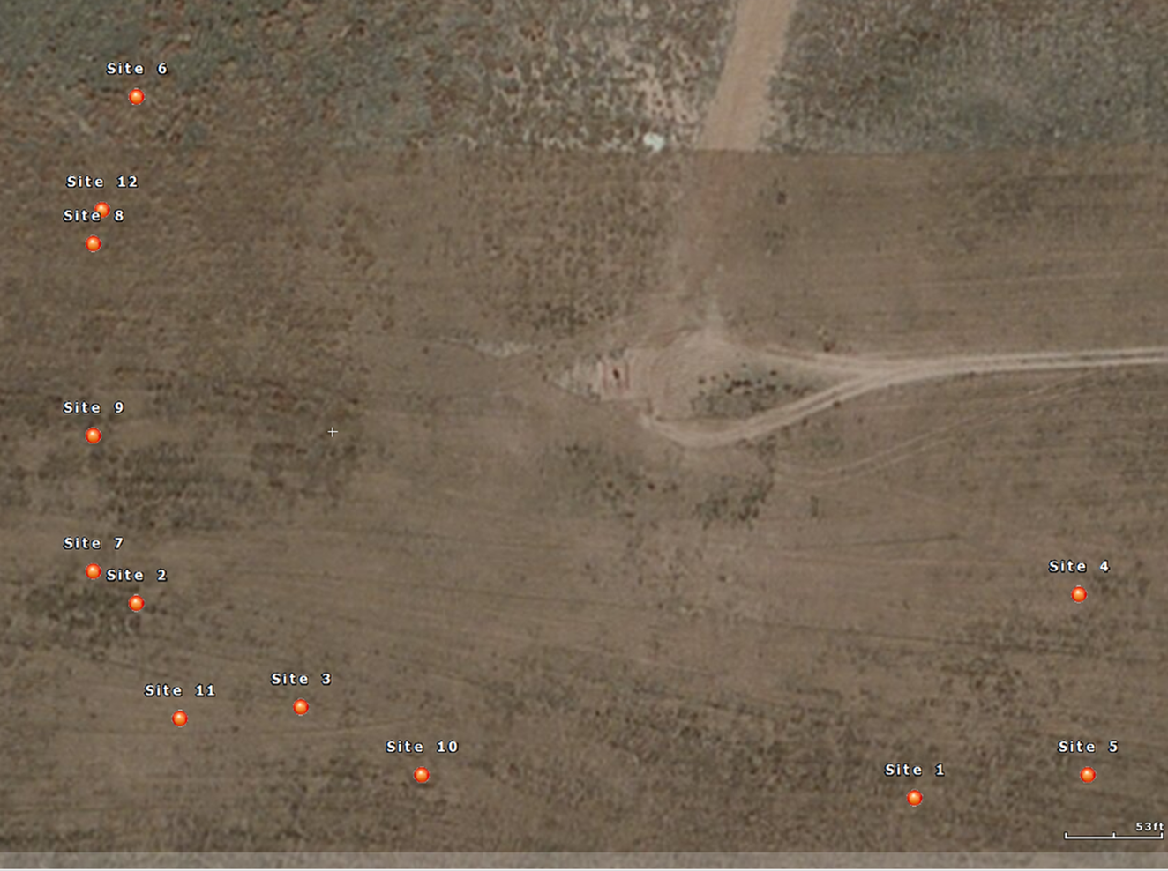
Repositioned Site 2 Monitors (based on wind forecasts)

Slide 8
Initial Observations
Monitoring data collected contain a wealth of information for evaluating models and understanding NO2 conversion in near-field (this is new information).
Fresh O3 may not be mixed through the entire cross section of the plume. This is an important finding.
Data are available to evaluate the accuracy of NO2 and NOx models.
Data need careful evaluation post field sampling.

Slide 9
Contractor Deliverables (Expected by end of December)
All hourly and five-minute raw and annotated (i.e., flagged) ambient monitoring data for both drill pads, including detailed site layout of the NOx monitors and drill pad structures
All ambient monitor calibration and QC check data, including dates, times, and results
All hourly and five-minute emissions data for both drill pads and the associated calibration and QC data
Final Quality Assurance Project Plan

